Slide 1
HUMAN RESOURCE management
Pham Gia Phuc
Nguyen Tan Dung
Tran Dac Minh
Dang Gia Linh
Nguyen Viet Duc
TEAM ANOTHER​

Slide 2
Why use
- Help Save Time and Energy
- Access HR Anytime, Anyplace
- Make it easier to analyze big data
- User friendly, everyone can use

Slide 3
About Dreamcatcher
- A software that provides basic solution for consulting, staffing and recruiting.
- Improves all aspects of business: workflow, tracking and controlling. ​

Slide 4
Structure​
STAFF
MANAGER​
+ Can edit staff’s information & salary
+ Can look up staff & employee’s information and salary
+ Can look up & edit employee’s in each office of their own

Slide 5
Class
Manager ( ID, Name, DOB, Gender, Account )
Staff ( ID, Name, DOB, Gender, Account, Office )
Employee ( ID, Name, DOB, Gender, Office )
Salary ( ID, Working hour, Wage/hour, Total Receive )

Slide 6
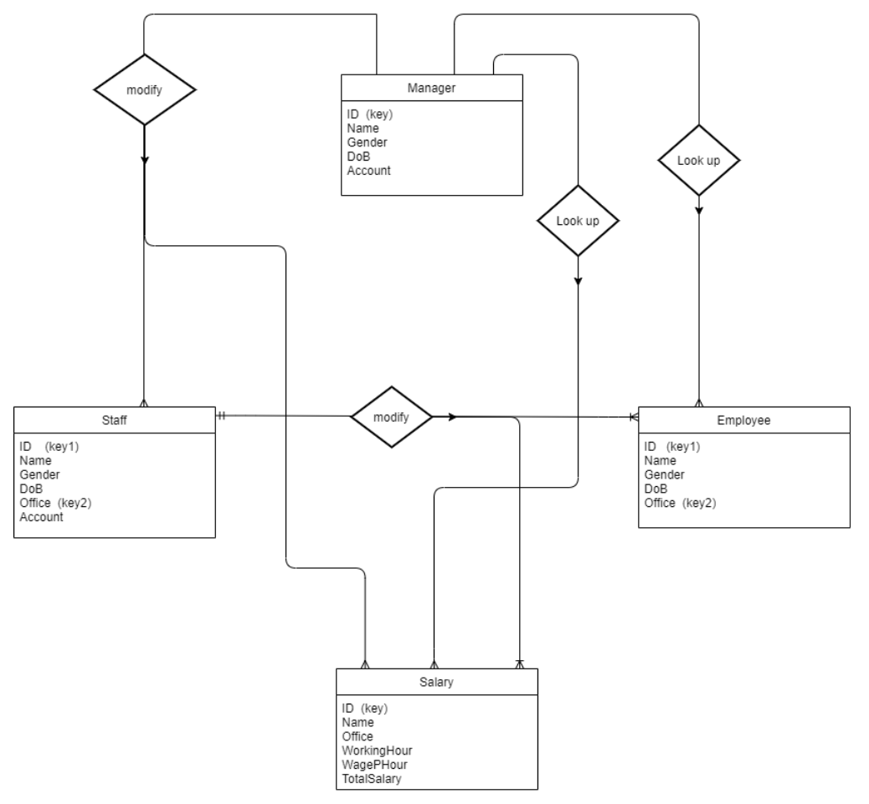
Database Diagram

Slide 7
Domain​
STAFF
EMPLOYEE
SALARY
4 Classes
MANAGER​

Slide 8
Module
01
04
Tkinter
Pickle
02
05
Math
Os
03
Manager.py & Staff.py & Check function
06
Datetime
(UI creation)
(create & read database)
(calculate salaries)
(edit database file)
(check DoB format)
(run after correct login input)

Slide 9
DEMO
https://github.com/Lib3Rt9/pp2021/tree/master/ProjectMid2/ProjectMid2/Human%20Resource

Slide 10
CONCLUSION
Sorting one column
Searching
Querying
General
HOWEVER
Compared to excel or sql, it still lacks a lot of functions
The program has the basic functions of a management system
Easy to use
Friendly user interface

Slide 11
Thanks For Listening

